Slide 1
Agent-Based Gathering Simulations
Roy Levi Sagiv WHAT??

Slide 2
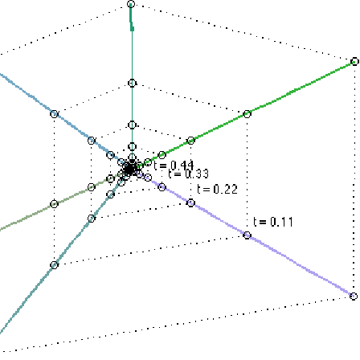
The Goal of Gathering
The goal of gathering is for many identical mobile agents to come together to perform tasks as a cohesive group using only their sensors to detect the relative locations of others in their vicinity.

Slide 3
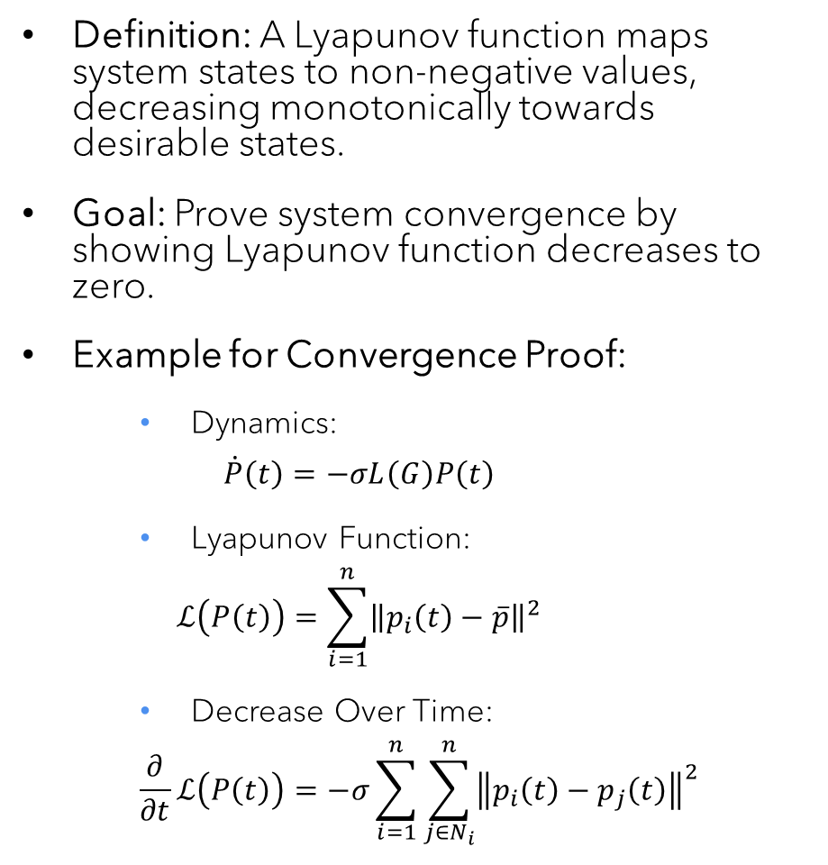
Convergence Analysis with Lyapunov Functions DECIDE WHICH ONE!!!!!
Definition: A Lyapunov function maps system states to non-negative values, decreasing monotonically towards desirable states.
Goal: Prove system convergence by showing Lyapunov function decreases to zero.
Example for Convergence Proof:
Dynamics:
$$\dot{P}\left(t\right)=−σL\left(G\right)P\left(t\right)$$
Lyapunov Function:
$$ℒ\left(P\left(t\right)\right)=\sum_{i=1}^{n}{{\left\|p_{i}\left(t\right)−\overline{p}\right\|}^{2}}$$
Decrease Over Time:
$$\frac{∂}{∂t}ℒ\left(P\left(t\right)\right)=−σ\sum_{i=1}^{n}{\sum_{j∈N_{i}}^{n}{{\left\|p_{i}\left(t\right)−p_{j}\left(t\right)\right\|}^{2}}}$$

Slide 4
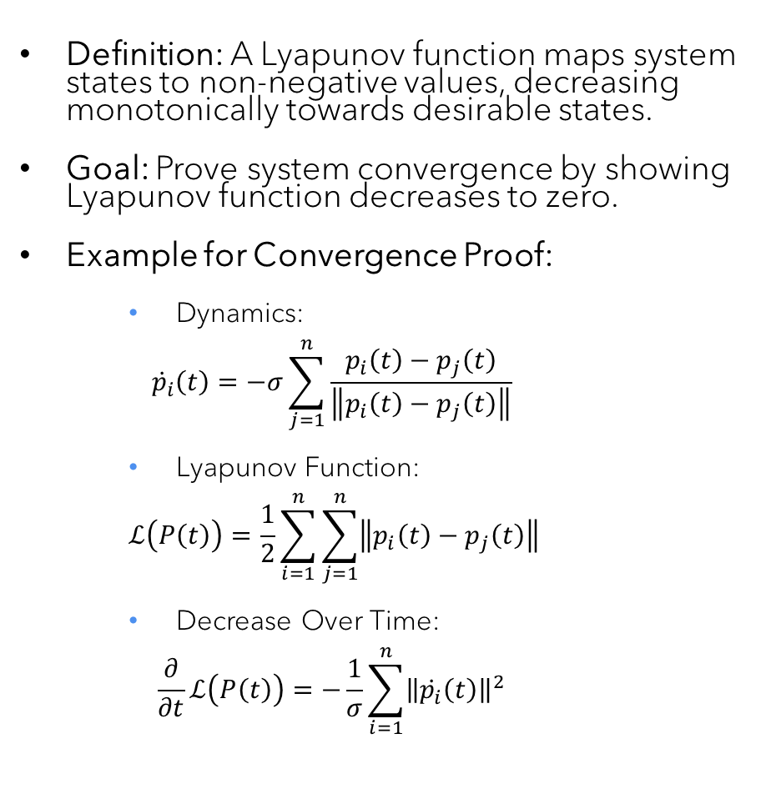
Convergence Analysis with Lyapunov Functions DECIDE WHICH ONE!!!!!
Definition: A Lyapunov function maps system states to non-negative values, decreasing monotonically towards desirable states.
Goal: Prove system convergence by showing Lyapunov function decreases to zero.
Example for Convergence Proof:
Dynamics:
$${\dot{p}}_{i}\left(t\right)=−σ\sum_{j=1}^{n}{\frac{p_{i}\left(t\right)−p_{j}\left(t\right)}{\left\|p_{i}\left(t\right)−p_{j}\left(t\right)\right\|}}$$
Lyapunov Function:
$$ℒ\left(P\left(t\right)\right)=\frac{1}{2}\sum_{i=1}^{n}{\sum_{j=1}^{n}{\left\|p_{i}\left(t\right)−p_{j}\left(t\right)\right\|}}$$
Decrease Over Time:
$$\frac{∂}{∂t}ℒ\left(P\left(t\right)\right)=−\frac{1}{σ}\sum_{i=1}^{n}{{\left\|\dot{p_{i}}\left(t\right)\right\|}^{2}}$$

Slide 5
Collision Avoidance Mechanisms
Efficient Collision Avoidance in Multi-Agent Systems

Slide 6
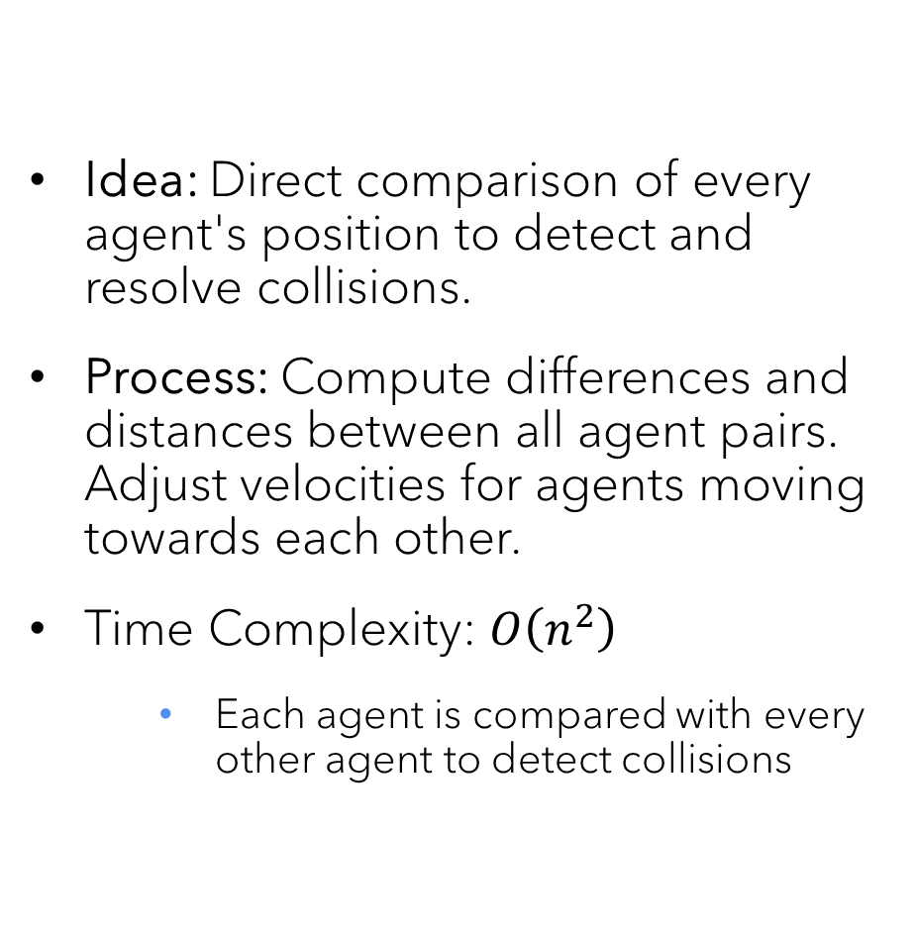
Naive Collision Adjustment
Idea: Direct comparison of every agent's position to detect and resolve collisions.
Process: Compute differences and distances between all agent pairs. Adjust velocities for agents moving towards each other.
Time Complexity: $O\left(n^{2}\right)$
Each agent is compared with every other agent to detect collisions

Slide 7
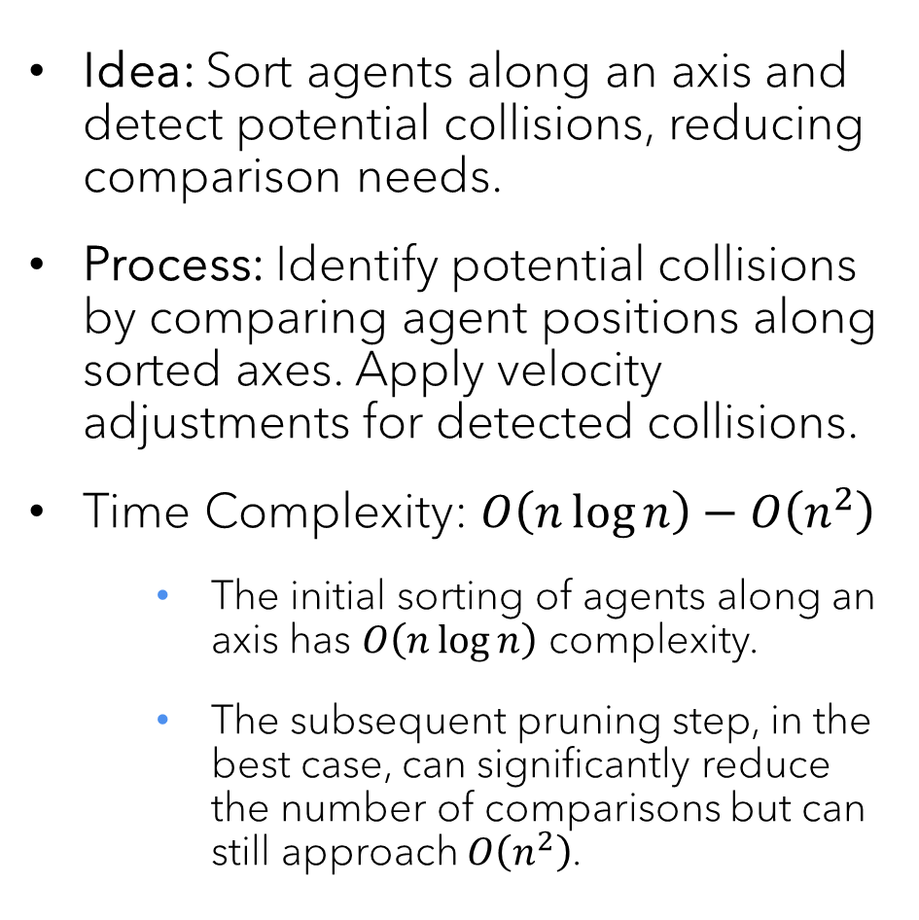
Sweep and Prune Method
Idea: Sort agents along an axis and detect potential collisions, reducing comparison needs.
Process: Identify potential collisions by comparing agent positions along sorted axes. Apply velocity adjustments for detected collisions.
Time Complexity: $O\left(n\log{n}\right)−O\left(n^{2}\right)$
The initial sorting of agents along an axis has $O\left(n\log{n}\right)$ complexity.
The subsequent pruning step, in the best case, can significantly reduce the number of comparisons but can still approach $O\left(n^{2}\right)$.

Slide 8
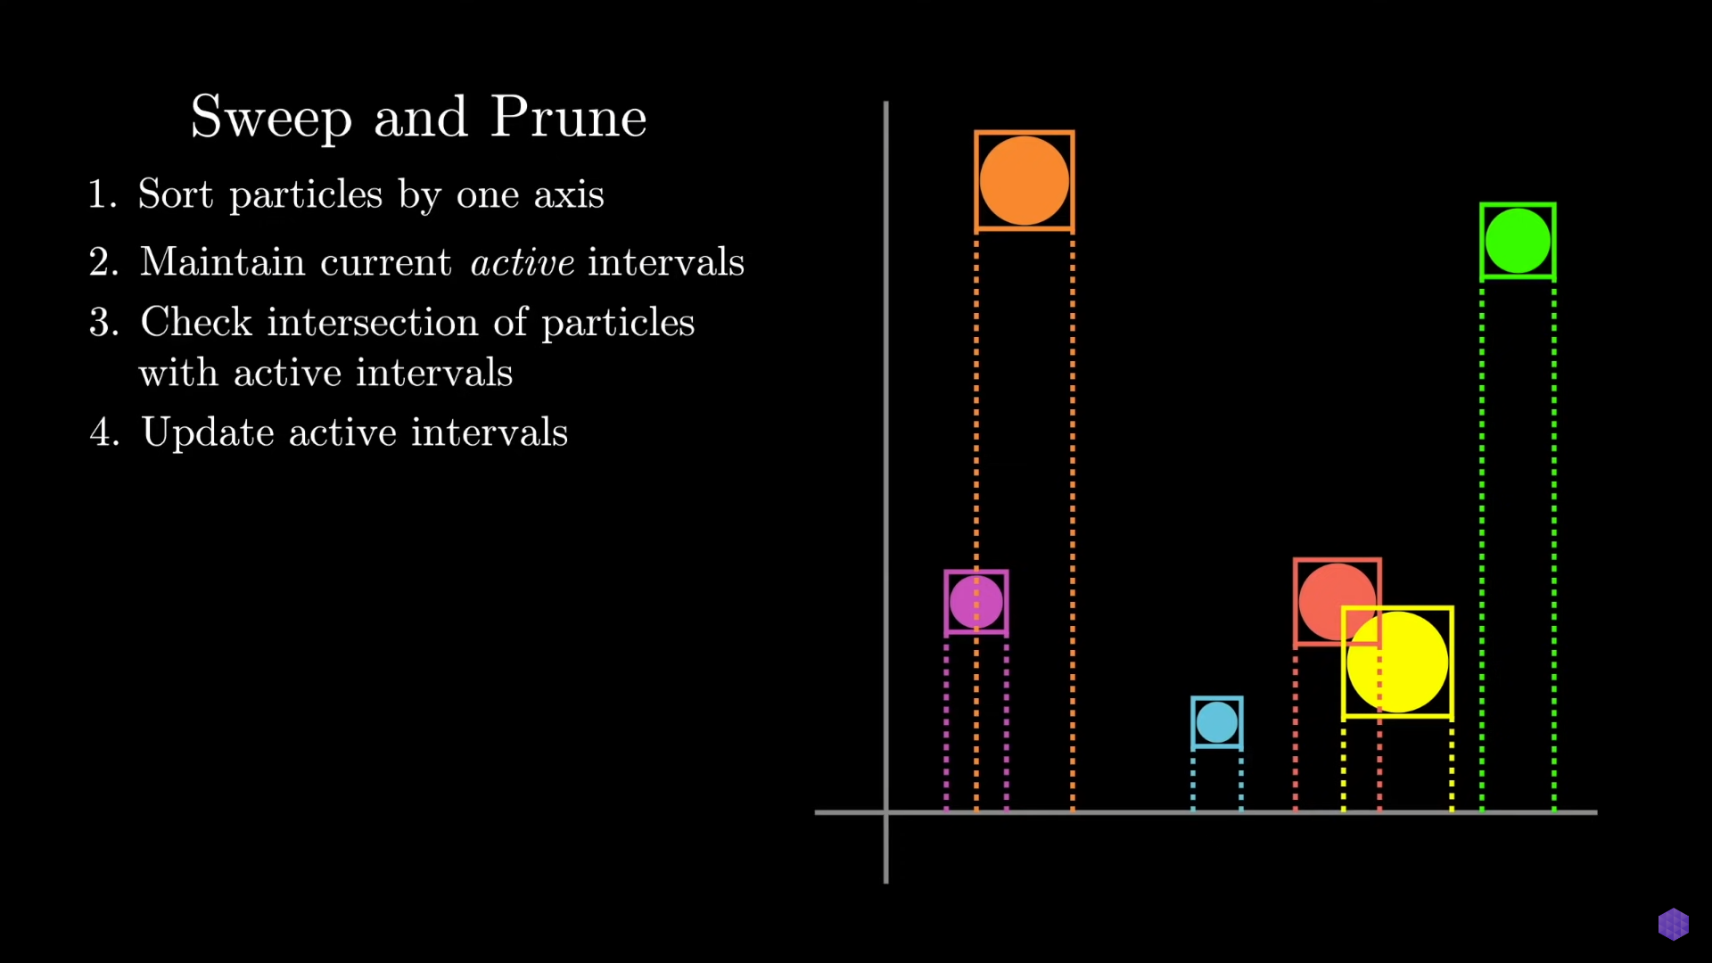

Slide 9
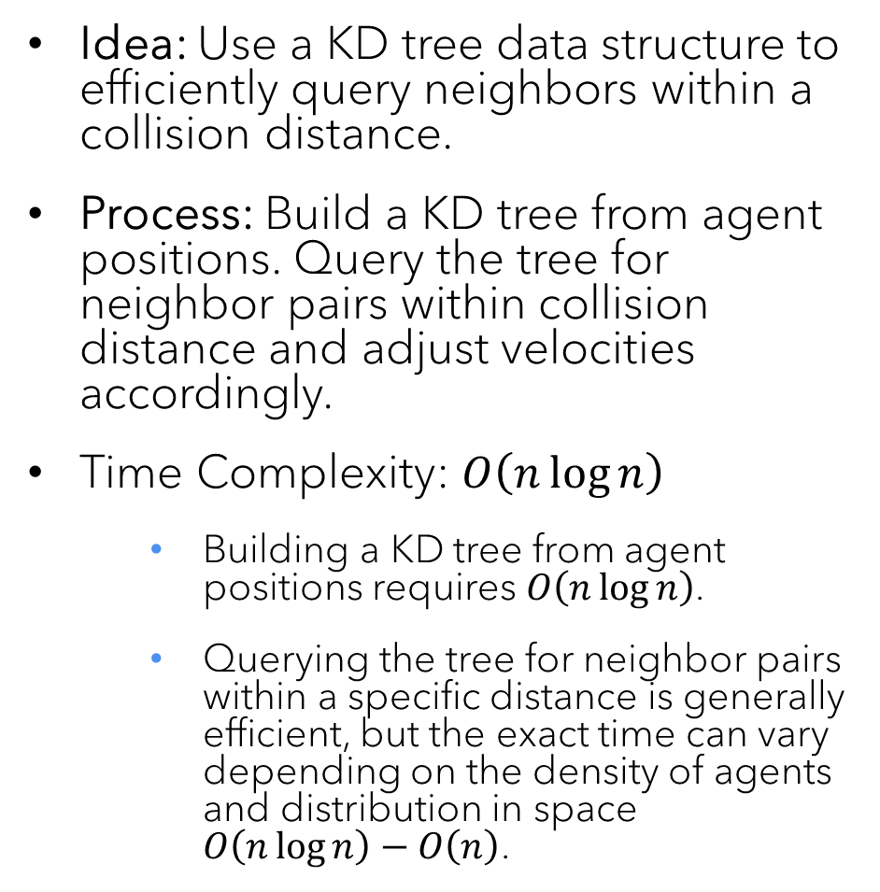
KD-Tree Based Adjustment
Idea: Use a KD tree data structure to efficiently query neighbors within a collision distance.
Process: Build a KD tree from agent positions. Query the tree for neighbor pairs within collision distance and adjust velocities accordingly.
Time Complexity: $O\left(n\log{n}\right)$
Building a KD tree from agent positions requires $O\left(n\log{n}\right)$.
Querying the tree for neighbor pairs within a specific distance is generally efficient, but the exact time can vary depending on the density of agents and distribution in space $O\left(n\log{n}\right)−O\left(n\right)$.

Slide 10
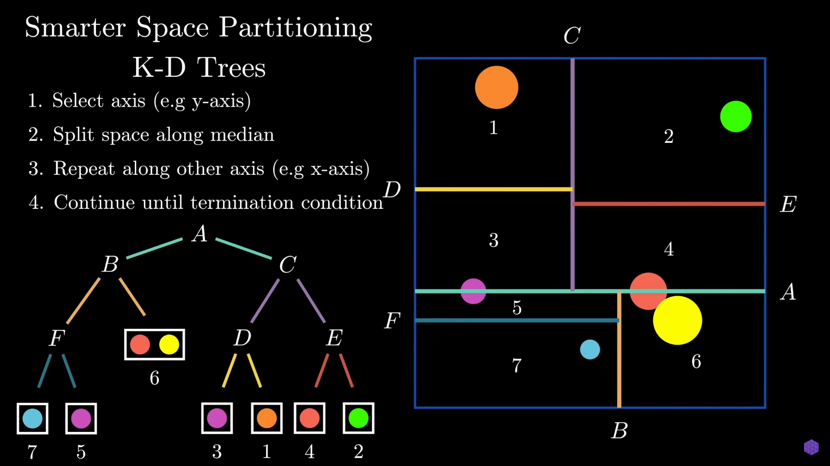

Slide 11
DEMO
YAY!

Slide 13
Agenda
Introduction
Building confidence
Engaging the audience
Visual aids
Final tips & takeaways

Slide 14

The power of communication

Slide 15

Overcoming nervousness
Confidence-building
strategies

Slide 16
Engaging the audience
Make eye contact with your audience to create a sense of intimacy and involvement
Weave relatable stories into your presentation using narratives that make your message memorable and impactful
Encourage questions and provide thoughtful responses to enhance audience participation
Use live polls or surveys to gather audience opinions, promoting engagement and making sure the audience feel involved

Slide 17
Effective delivery techniques
This is a powerful tool in public speaking. It involves varying pitch, tone, and volume to convey emotion, emphasize points, and maintain interest.
Pitch variation
Tone inflection
Volume control
Effective body language enhances your message, making it more impactful and memorable.
Meaningful eye contact
Purposeful gestures
Maintain good posture
Control your expressions

Slide 18
Navigating Q&A sessions
Know your material in advance
Anticipate common questions
Rehearse your responses
Maintaining composure during the Q&A session is essential for projecting confidence and authority. Consider the following tips for staying composed:
Stay calm
Actively listen
Pause and reflect
Maintain eye contact

Slide 19

Speaking impact
Your ability to communicate effectively will leave a lasting impact on your audience
Effectively communicating involves not only delivering a message but also resonating with the experiences, values, and emotions of those listening

Slide 20
Dynamic delivery
Learn to infuse energy into your delivery to leave a lasting impression
One of the goals of effective communication is to motivate your audience
Metric | Measurement | Target | Actual
Audience attendance | # of attendees | 150 | 120
Engagement duration | Minutes | 60 | 75
Q&A interaction | # of questions | 10 | 15
Positive feedback | Percentage (%) | 90 | 95
Rate of information retention | Percentage (%) | 80 | 85

Slide 21
Final tips & takeaways
Consistent rehearsal
Strengthen your familiarity
Refine delivery style
Pacing, tone, and emphasis
Timing and transitions
Aim for seamless, professional delivery
Practice audience
Enlist colleagues to listen & provide feedback
Seek feedback
Reflect on performance
Explore new techniques
Set personal goals
Iterate and adapt

Slide 22
Speaking engagement metrics
Impact factor | Measurement | Target | Achieved
Audience interaction | Percentage (%) | 85 | 88
Knowledge retention | Percentage (%) | 75 | 80
Post-presentation surveys | Average rating | 4.2 | 4.5
Referral rate | Percentage (%) | 10 | 12
Collaboration opportunities | # of opportunities | 8 | 10

Slide 23
Thank you
Brita Tamm
502-555-0152
brita@firstupconsultants.com
www.firstupconsultants.com

